Slide 1
Food Services Division
Dress Code Policy
Provided by the LAUSD Food Services Division
9.1.21
Notes:
TELL: Welcome to the Food Services Dress Code Policy training. Thank you for being here today. My name is (state your name).

Slide 2
Dress Code Policy
All Food Services Division (FSD) employees must always comply with the Division’s Dress Code Policy during their regular assigned hours.
Food Service Substitute workers are required to wear white polo, plain black pants, and slip-resistant shoes to every assignment.
Shirt: White polo (logos under 1”)
Pants: Plain black pants (no jeans)
Shoes: Slip-resistant shoes
Notes:
TELL: Effective February 13th, 2017 all Food Services Division (FSD) employees Managers, Seniors, Drivers, and Workers (including substitutes) must comply with the Division’s Dress Code Policy at all times during their regular assigned hours.

Slide 3
Approved Attire Sample
Men & Women
Smile
White Polo Style Shirt
Black Pants
Slip Resistant Shoes
Notes:
TELL: These are some examples, of the attire you will wear.
ASK: What type of shirt, as a Substitute, would you be able to wear? Answer: A white polo.

Slide 4
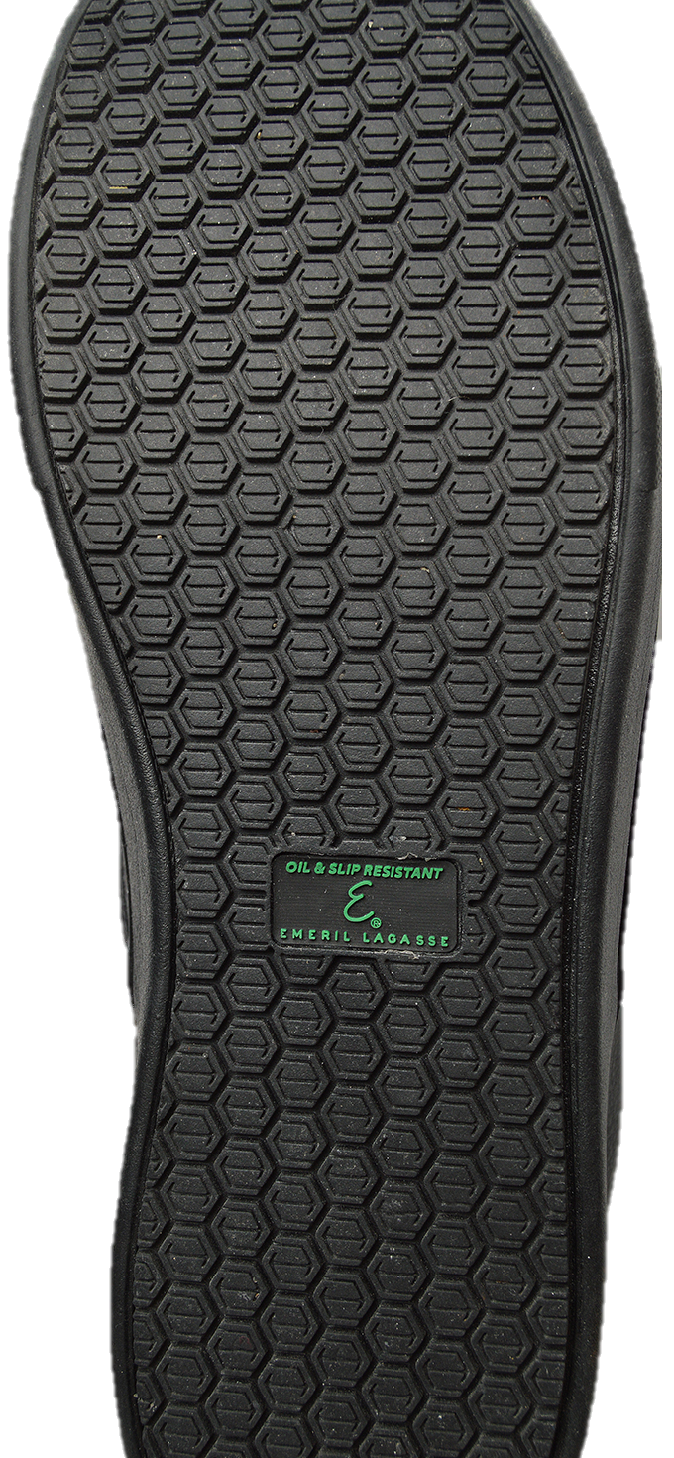
Slip-Resistant Shoes
Food Services employees work around machinery and hot foods, their feet must be adequately protected from possible injury. Employees must wear comfortable, low or no heel closed-toe shoes with slip-resistant soles. Look for “Slip Resistant” stamped on the sole or printed on the box.
Shoes must be leather or leather-like
No perforated material (Mesh)
Notes:
TELL: Because Food Services employees work around machinery and hot foods, their feet must be adequately protected from possible injury. Employees must wear comfortable, low or no heel closed-toe shoes with slip-resistant soles. Look for “Slip Resistant” stamped on the sole of the shoe. Examples of approved shoes are food services industry shoes, leather or leather-like tennis shoes without any airholes, and other leather or leather-like shoes.
Note: “Oil Resistant” does NOT mean slip resistant.

Slide 5
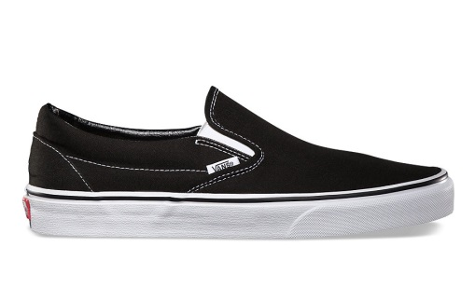
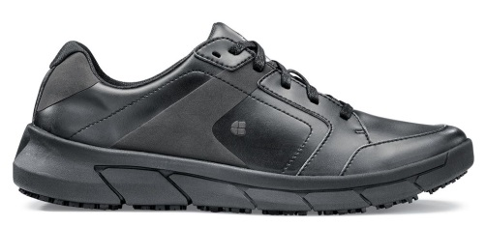
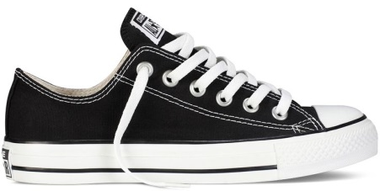
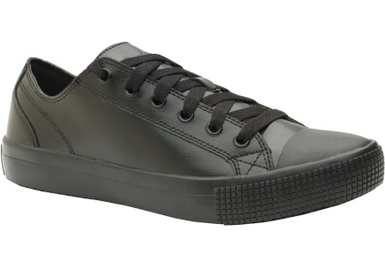
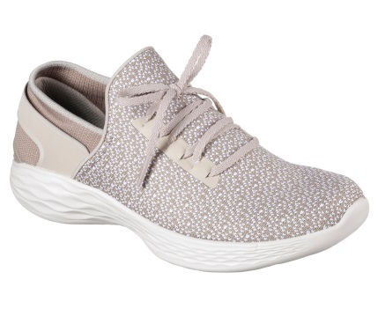
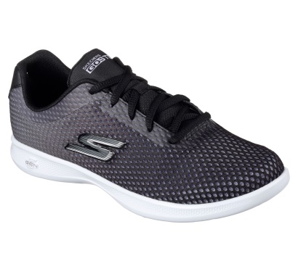
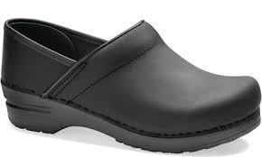
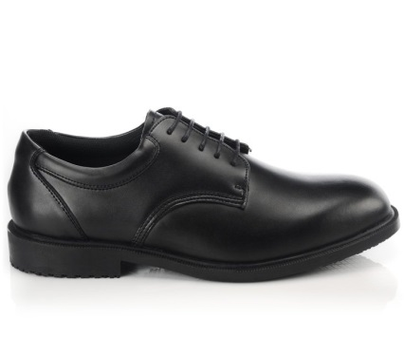
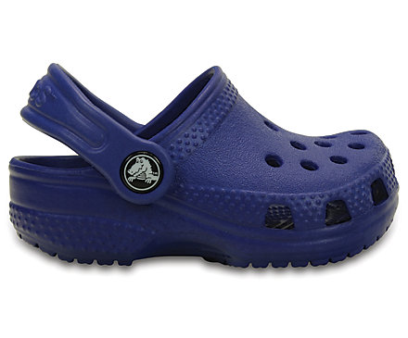
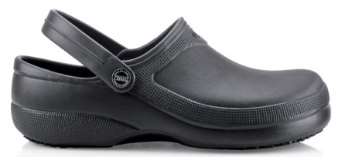
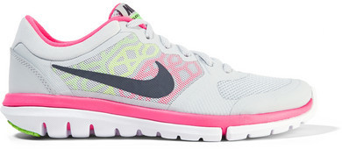
Shoes
Approved Shoes
Unapproved Shoes
Notes:
TELL: Let’s take a look at the some of the approved shoes you can wear. All the shoes are leather or leather like shoes and are slip resistant. The work clog/crocs are approved because they have no holes, an enclosed heel and have a slip resistant sole.
These are unapproved shoes that can not be worn in the cafeteria, converse, vans, mesh, and tennis shoe that have a combination of leather and mesh. The crocs are unapproved because they have holes in the shoe, do not cover the heel and are not made for the work industry. All these shoes are not slip resistant and not allowed due to safety concerns.

Slide 6
Why Wear Slip-Resistant Shoes?
Slip resistant-shoes increase traction in slippery environments by using special sole materials and tread design to prevent falls.
A slip and fall accident at work can have serious repercussions:
Physical, financial, and mental
Protecting yourself with slip resistant shoes makes you a more productive team member when you are not worried about:
Slipping or getting hurt at work
Your health isn’t something to gamble with, so protect yourself with the right safety footwear.
The most dangerous part in the cafeteria is the floor.
Notes:
TELL: Why should you wear slip resistant shoes while working in the cafeteria? Because slip resistant-shoes increase traction in slippery environments by using special sole materials and tread design to prevent falls. A slip and fall accident at work can have serious repercussions physical, financial, and mental. Protecting yourself with slip resistant shoes makes you a more productive team member when you aren’t worried about slipping at work or getting hurt.
Your health isn’t something to gamble with, so protect yourself with the right safety footwear.
Remember the most dangerous part in the cafeteria is the floor.
physical – A slip and fall accident can result in broken bones, bruises, sprains and even concussions.
Financial – An injury such as those listed can leave out of work for days or even weeks.
Mental – The stress of not working while bills pile up, of not having full motor function, of having to physically recover so that you can return to work, these all affect your mental state.

Slide 7
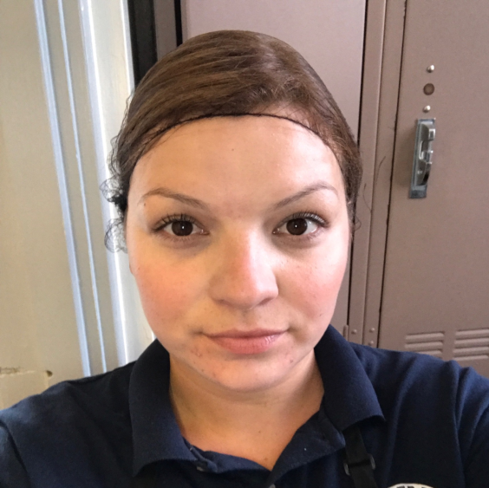
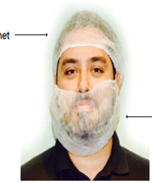
Approved Hair and Beard Covering
All employees must continue to wear the approved hairnet coverings at all times and all loose hair must be fully covered.
Employees with any facial hair must wear a beard snood.
Note: Bandanas and baseball caps are prohibited.
Notes:
TELL: All employees must continue to wear the approved hairnet coverings at all times and all loose hair must be fully covered. Employees with facial hair must wear a beard snood, this includes mustaches.
Bandanas and all hats are prohibited.

Slide 8
Religious Head Covering
Employees wearing religious/ethnic head coverings may continue to do so provided it does not pose a safety or sanitation concern.
If the head covering poses a potential safety or sanitation concern, a meeting will be held with the immediate supervisor and/or HR to discuss possible accommodations.
Notes:
TELL: Employees wearing religious/ethnic head coverings may continue to do so provided it does not pose a safety or sanitation concern. If the head covering poses a potential safety or sanitation concern, a meeting will be held with the immediate supervisor and/or HR to discuss possible accommodations. Hairnets should be over hair. However due to the sensitivity of some religions, if the headwear reasonably shows that no hair will escape, Managers are not required to ask employees to take off their covering for proof that an hairnet is underneath. If the head covering is loose and hangs down where it is a sanitary concern, the employee will need to tuck or pin the clothes to insure sanitation.

Slide 9
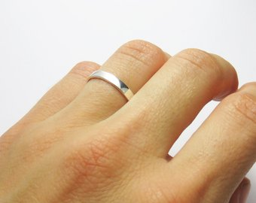
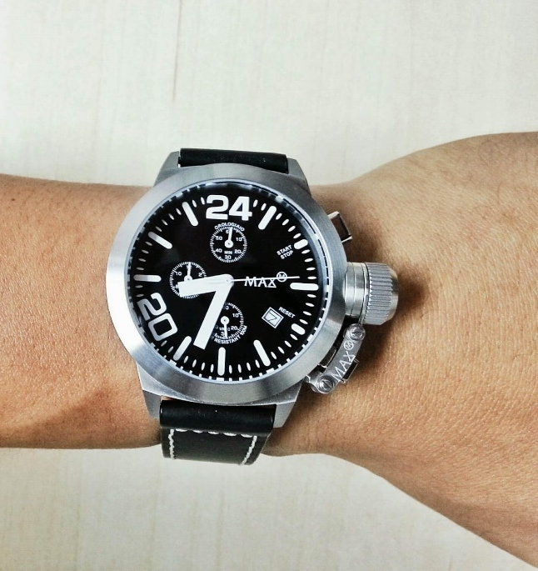
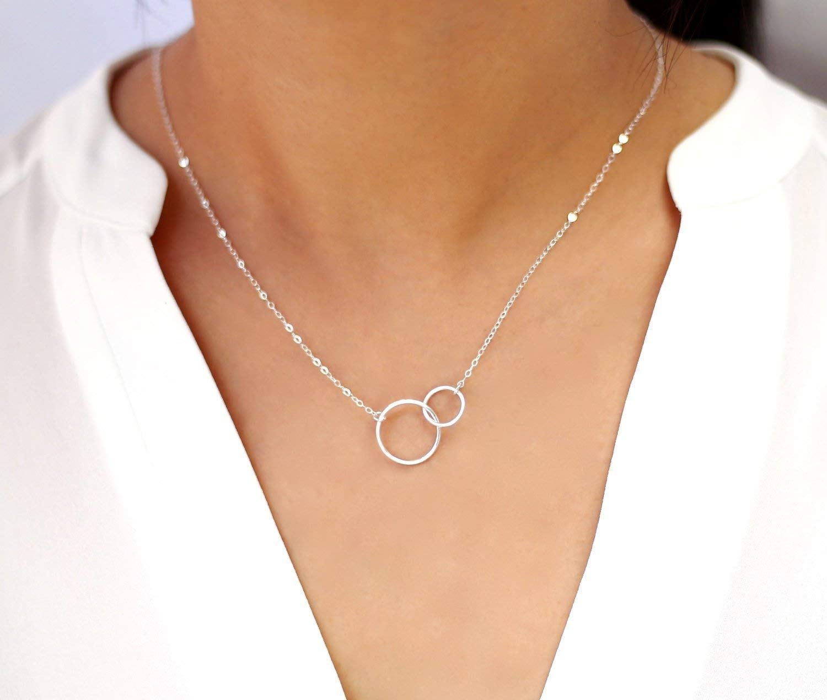
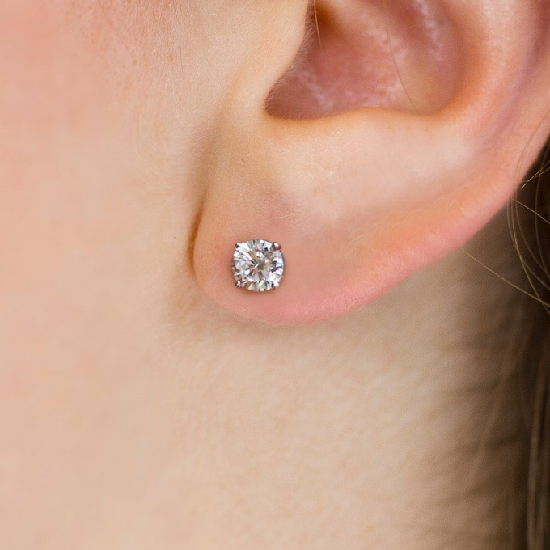
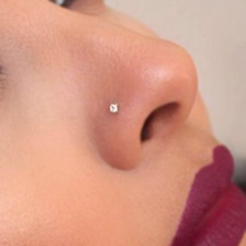
Jewelry & Accessories
Only a single plain band ring is allowed.
Watches, necklaces, earrings, nose rings, tongue rings, or any facial jewelry are not permitted.

Slide 10
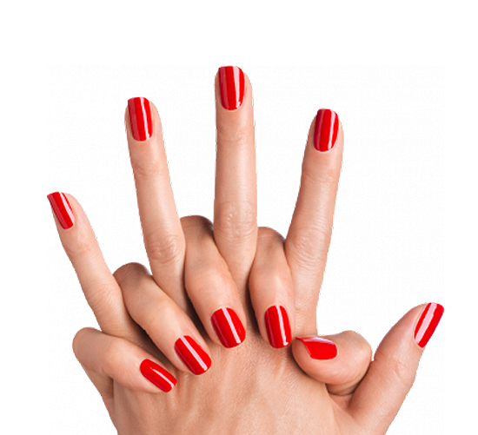
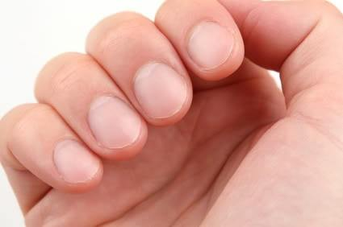
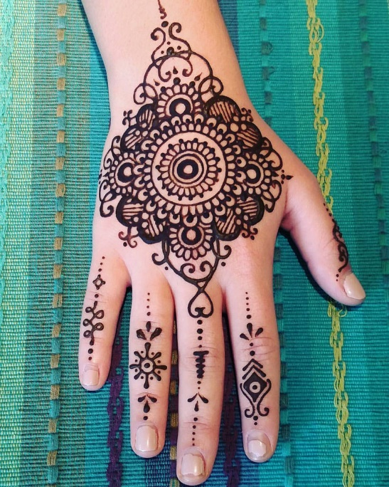
Hands & Nails
Nails must be short, neat and clean.
Nail polish (regular, gel or henna) are not permitted.

Slide 11
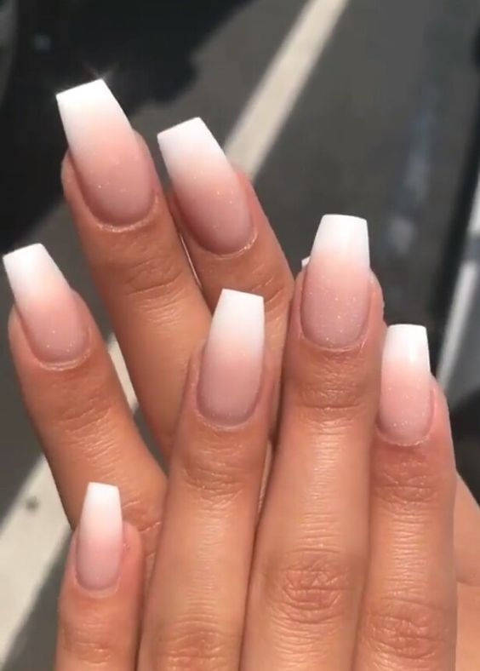
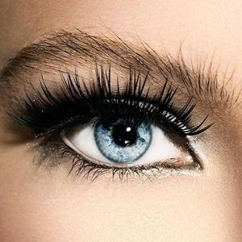
No Falsies
False nails or eyelashes are not permitted.

